Slide 1
Building Data Pipelines with Airflow DAGs
C8-Week-3
The key advantage of Apache Airflow's approach to representing data pipelines as DAGs is that they are expressed as code, which makes your data pipelines more maintainable, testable, and collaborative. Tasks, the nodes in a DAG, are created by implementing Airflow's built-in operators.​In this module, you will learn about Apache Airflow having a rich UI that simplifies working with data pipelines. You will explore how to visualize your DAG in graph or tree mode. You will also learn about the key components of a DAG definition file, and you will learn that Airflow logs are saved into local file systems and then sent to cloud storage, search engines, and log analyzers.
Learning Objectives
List the main features and principles of Apache Airflow​
Identify common use cases for Apache Airflow.
Describe workflows as DAGs of tasks and dependencies
List key advantages of defining workflows as code
Show current DAGs in your environment
Summarize different ways to visualize a specific DAG
List a DAG’s tasks and pause a DAG in Apache Airflow.
List the key components of a DAG definition file
Create tasks by instantiating operators in a DAG definition file
Create and submit a DAG.
Use logging capabilities to monitor the task status and diagnose problems with DAG runs
Explain accessing emitted metrics such as counters, gauges, and timers
Monitor a DAG in Apache Airflow’s web UI.

Slide 2
Using Apache Airflow to Build Data Pipelines
Recognize Apache Airflow as a platform to programmatically author, schedule, and monitor workflows.
List the main features and principles of Apache Airflow.
List common use cases for Apache Airflow.

Slide 3
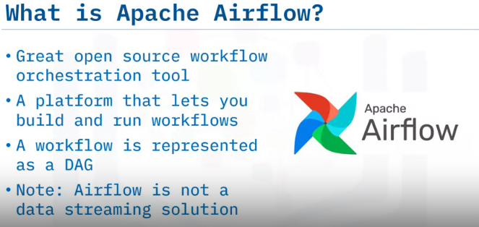
Apache Airflow is a great open source workflow orchestration tool that is supported by an active community.
It is a platform that lets you build and run workflows, such as batch data pipelines.
With Apache Airflow, a workflow is represented as a DAG (a Directed Acyclic Graph), and contains individual pieces of work called tasks, arranged with dependencies.
And, note that unlike Big Data tools such as Apache Kafka, Apache Storm, Apache Spark, or Flink, Apache Airflow is not a data streaming solution. It is primarily a workflow manager.

Slide 4
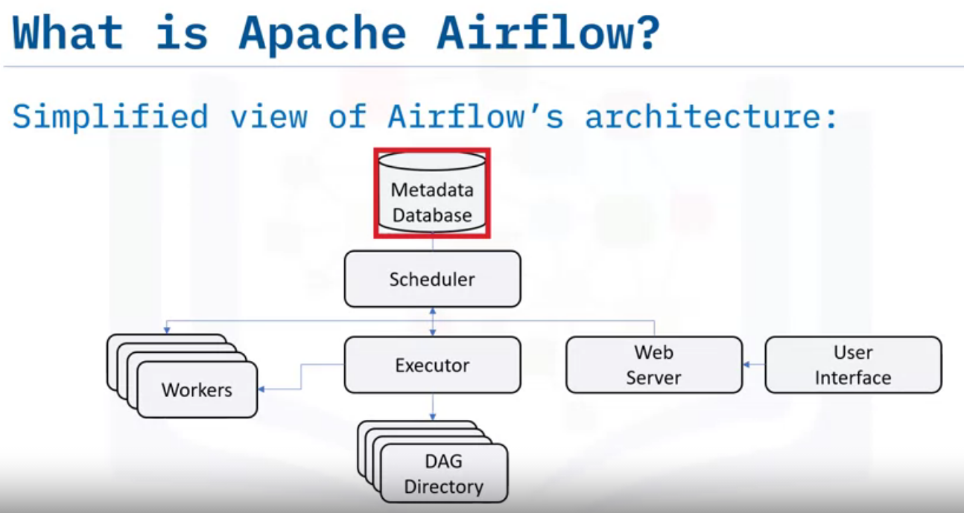
Airflow’s basic components.
Airflow comes with a built-in Scheduler, which handles the triggering of all scheduled workflows.
The Scheduler is responsible for submitting individual tasks from each scheduled workflow to the Executor.
The Executor handles the running of these tasks by assigning them to Workers, which then run the tasks.
The Web Server , serves Airflow’s powerful interactive User Interface.
From this UI, you can inspect, trigger and debug any of your DAGs and their individual tasks.
The DAG Directory contains all of your DAG files, ready to be accessed by the Scheduler, the Executor, and each of its employed Workers.
Finally, Airflow hosts a Metadata Database, which is used by the Scheduler, Executor, and the Web Server to store the state of each DAG and its tasks.

Slide 5
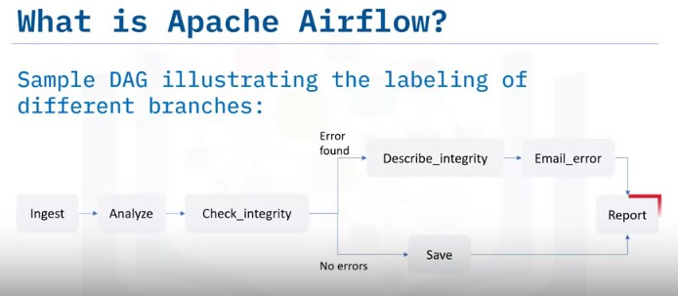
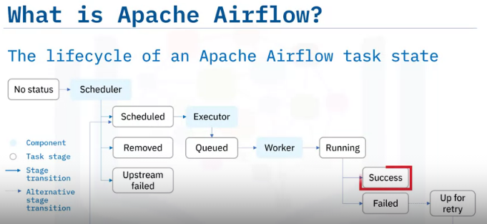
A DAG specifies the dependencies between tasks, and the order in which to execute them.
The tasks themselves describe what to do. In this example DAG, the tasks include data ingestion, data analysis, saving the data, generating reports, and triggering other systems, such as reporting any errors by email.
In this diagram, you can see how Apache Airflow might assign states to a task during its life cycle.
No status: This means that the task has not yet been queued for execution.
Scheduled: The scheduler has determined that the task’s dependencies are met and has scheduled it to run.
Removed: For some reason, the task has vanished from the DAG since the run started.
Upstream failed: An upstream task has failed.
Queued: The task has been assigned to the Executor and is waiting for a worker to become available.
Running: The task is being run by a worker.
Success: The task finished running without errors.
Failed: The task had an error during execution and failed to run
Up for retry: The task failed but has retry attempts left and will be rescheduled.
Ideally, a task should flow through the scheduler from ‘no status’, to ‘scheduled’, to ‘queued’, to ‘running’, and finally to ‘success.’

Slide 6
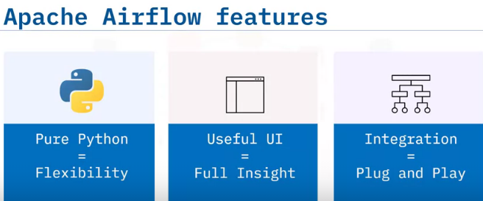
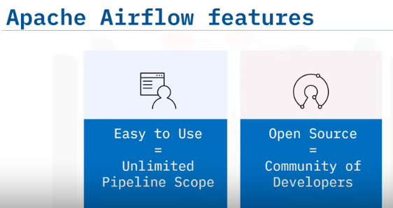
five main features and benefits of Apache Airflow.
Pure Python : Create your workflows using standard Python. This allows you to maintain full flexibility when building your data pipelines.
Useful UI : Monitor, schedule, and manage your workflows via a sophisticated web app, offering you full insight into the status of your tasks.
Integration : Apache Airflow provides many plug-and-play integrations, such as IBM Cloudant, that are ready to execute your tasks.
Easy to Use : Anyone with Python knowledge can deploy a workflow. Airflow does not limit the scope of your pipelines.
the open source feature : Whenever you want to share your improvement, you can do this by opening a pull request. Airflow has many active users who are sharing their experiences in the Apache Airflow community

Slide 7
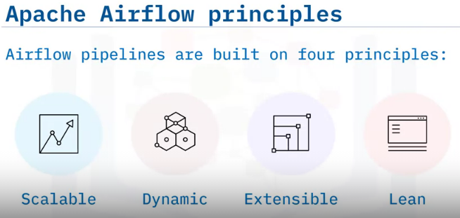
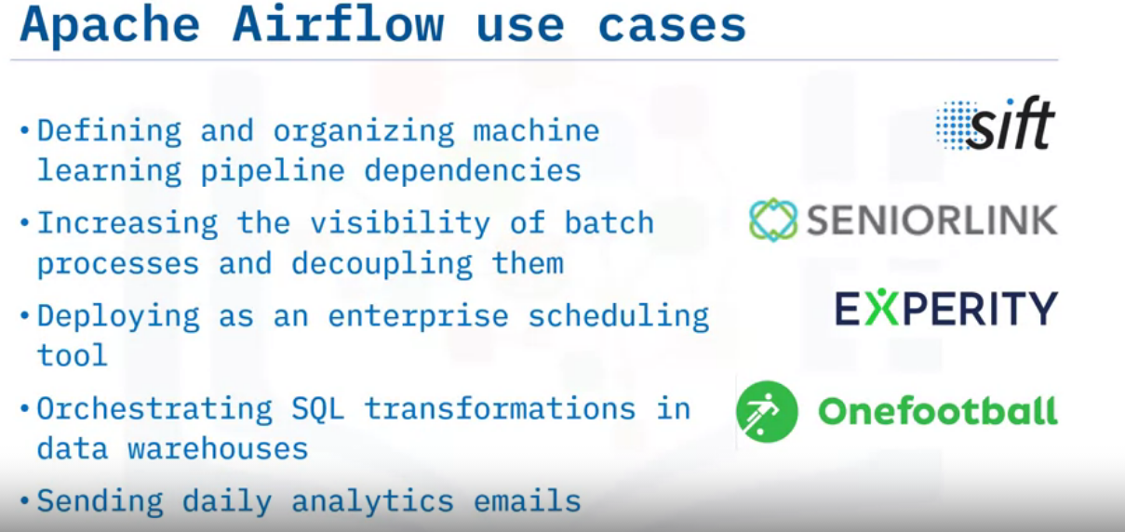
Apache Airflow pipelines are built on four main principles. They are:
Scalable: Airflow has a modular architecture and uses a message queue to orchestrate an arbitrary number of workers. It is ready to scale to infinity.
Dynamic: Airflow pipelines are defined in Python, and allow dynamic pipeline generation. Thus, your pipelines can contain multiple simultaneous tasks.
Extensible: You can easily define your own operators and extend libraries to suit your environment.
Lean: Airflow pipelines are lean and explicit. Parameterization is built into its core using the powerful Jinja templating engine.
Apache Airflow has supported many companies in reaching their goals. For example,
Sift used Airflow for defining and organizing Machine Learning pipeline dependencies,
SeniorLink increased the visibility of their batch processes and decoupled them,
Experity deployed Airflow as an enterprise scheduling tool, and
Onefootball used Airflow to orchestrate SQL transformations in their data warehouses, and to send daily analytics emails.

Slide 8
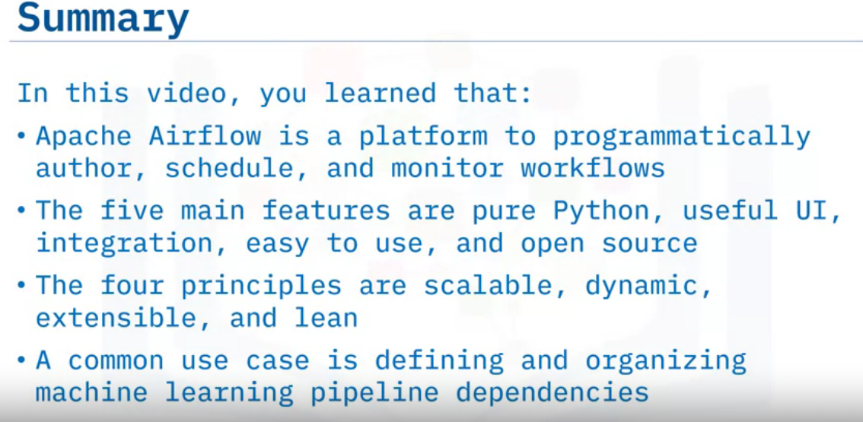

Slide 9
Advantages of Using Data Pipelines as DAGs in Apache Airflow
Define what a Directed Acyclic Graph, or DAG, is.
Describe workflows as DAGs of tasks and dependencies.
Outline the components of a DAG definition file.
Describe how Apache Airflow Scheduler executes tasks on an array of workers, and
List key advantages of defining workflows as code.

Slide 10
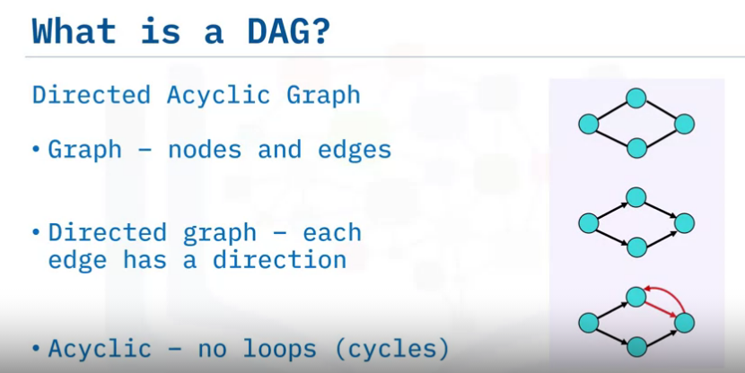
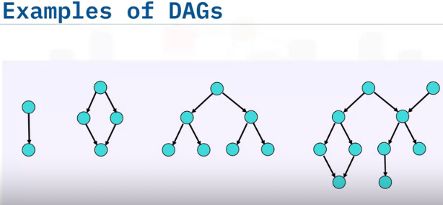
A 'DAG' is a special kind of graph, called a directed acyclic graph.
A simple graph consists of nodes and edges, like this. Here the circles are called nodes, and the lines connecting pairs of nodes are called edges.
A directed graph is also a graph, but it has a bit more structure. As you can see here, each edge has a specified direction. It connects a starting node with another node.
And lastly, the acyclic part means there are no loops, or sequences of directed edges that return to a node in the chain, such as the red cycle shown here.
The simplest nontrivial DAG has a single directed edge and looks like this. It has a single root node which is connected to a single terminal node.
Here's another DAG, which we've already seen. It also has single root and terminal nodes.
Here's an example of a tree , which is a commonly used graph for representing family trees or directory structures. All trees are DAGs, but not all DAGs are trees.
For example, this DAG is not a tree since it has more than one root node.
A DAG doesn't impose those restrictions, so a single node can have multiple parents and there may be multiple nodes with no parents.
1
2
3
4

Slide 11
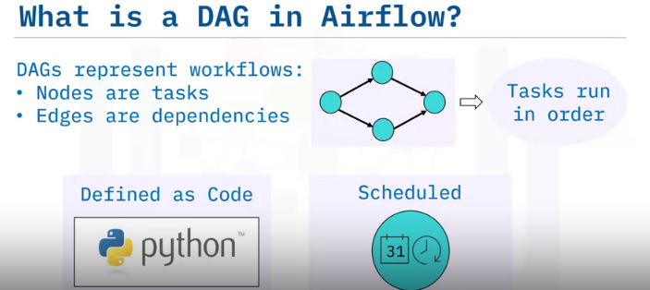
DAGs are used to represent workflows or pipelines in Apache Airflow.
Each task performed by your data pipeline is represented as a node in a DAG, while each of the dependencies between two tasks in your pipeline are represented as a directed edge in the DAG.
In other words, edges define the order in which the two tasks should run.
Thus, DAGs are used in Airflow to define what tasks should run, and in what sequence they should run.
A DAG is defined in a Python script, which represents the DAG’s structure.
Thus, the tasks and their dependencies are defined as code.
Also, scheduling instructions are specified as code in the DAG's script.

Slide 12
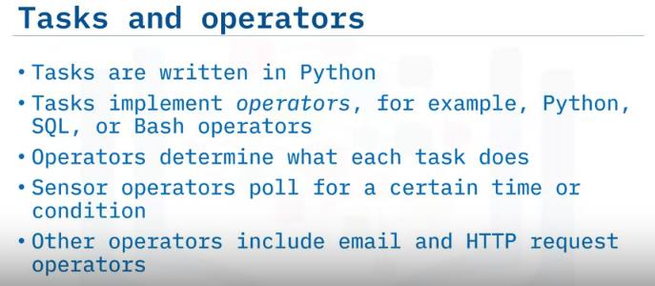
Just like the DAG itself, each task performed within your DAG is also written in Python.
Each task implements an operator: for example, a Python operator is used to deploy some Python code, a SQL operator to run a SQL query, and a Bash operator can be used to run a Bash command. Operators are used to define what each task in your DAG does.
Sensors are a class of operators which are used to poll for a certain time or condition to be met. For example, you can use a sensor to check every 30 seconds whether a file exists, or whether another DAG has finished running.
There are many other types of operators, including email and HTTP request operators.

Slide 13
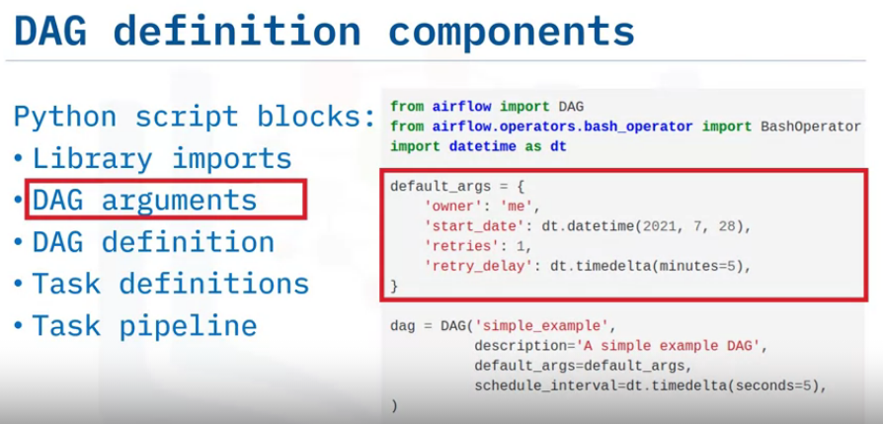
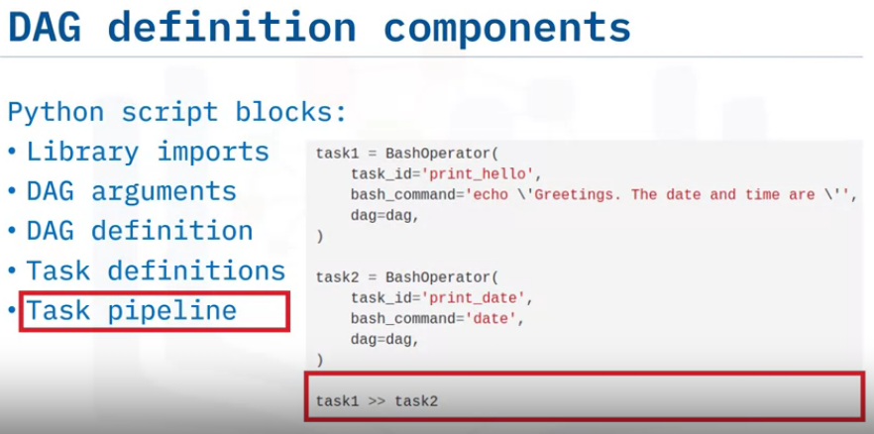
DAG python script consists: Library imports ,DAG arguments, DAG definition ,Task definitions, Task pipeline
The first block of your DAG definition script is where you import any Python libraries that you require. For example, the ‘from airflow import DAG’ command to import the DAG module from the Airflow collection.
The next block of code is for specifying default arguments for your DAG, such as its default ‘start date’.
Next comes the DAG definition, or instantiation block for your DAG, which specifies things like your default arguments.
Continuing along with our example DAG code, individual task definitions, which are the nodes of the DAG, form your DAG’s next building block. In this example we have two tasks, which happen to be Bash operators.
Finally, the task pipeline specifies the dependencies between your tasks.
Here 'task two' depends on the result of 'task one'. And this forms the last logical block of your DAG script

Slide 14
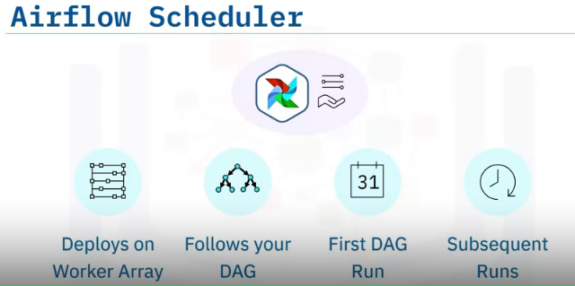
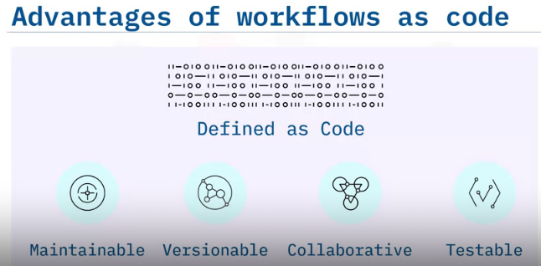
Your new DAG has been created, but it hasn't yet been deployed.
To that end, Airflow Scheduler is designed to run as a persistent service within an Airflow production environment. Apache Airflow Scheduler can be used to deploy your workflow on an array of workers.
It follows the tasks and dependencies that you specified in your DAG.
Once you start an Airflow Scheduler instance, your DAGs will start running based on the 'start date' you specified as code in each of your DAGs.
After that, the Scheduler triggers each subsequent DAG run according to the schedule interval you specified.
One of the key advantages of Apache Airflow's approach to representing data pipelines as DAGs is the fact that they are expressed as code.
When workflows are defined as code, they become more
Maintainable: Developers can follow explicitly what has been specified, by reading the code.
Versionable: Code revisions can easily be tracked by a version control system such as Git.
Collaborative: Teams of developers can easily collaborate on both development and maintenance of the code for the entire workflow, and
Testable: Any revisions can be passed through unit tests to ensure the code still works as intended.

Slide 15
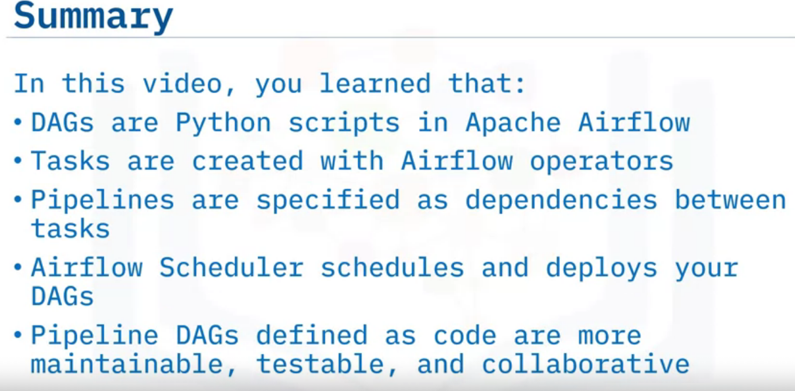

Slide 16
Apache Airflow UI
Identify current DAGs in your environment.
List different ways to visualize a specific DAG.
Review the code that defines your DAG.
Analyze the duration of each task in your DAG over multiple runs.
select context metadata for any task instance.

Slide 17
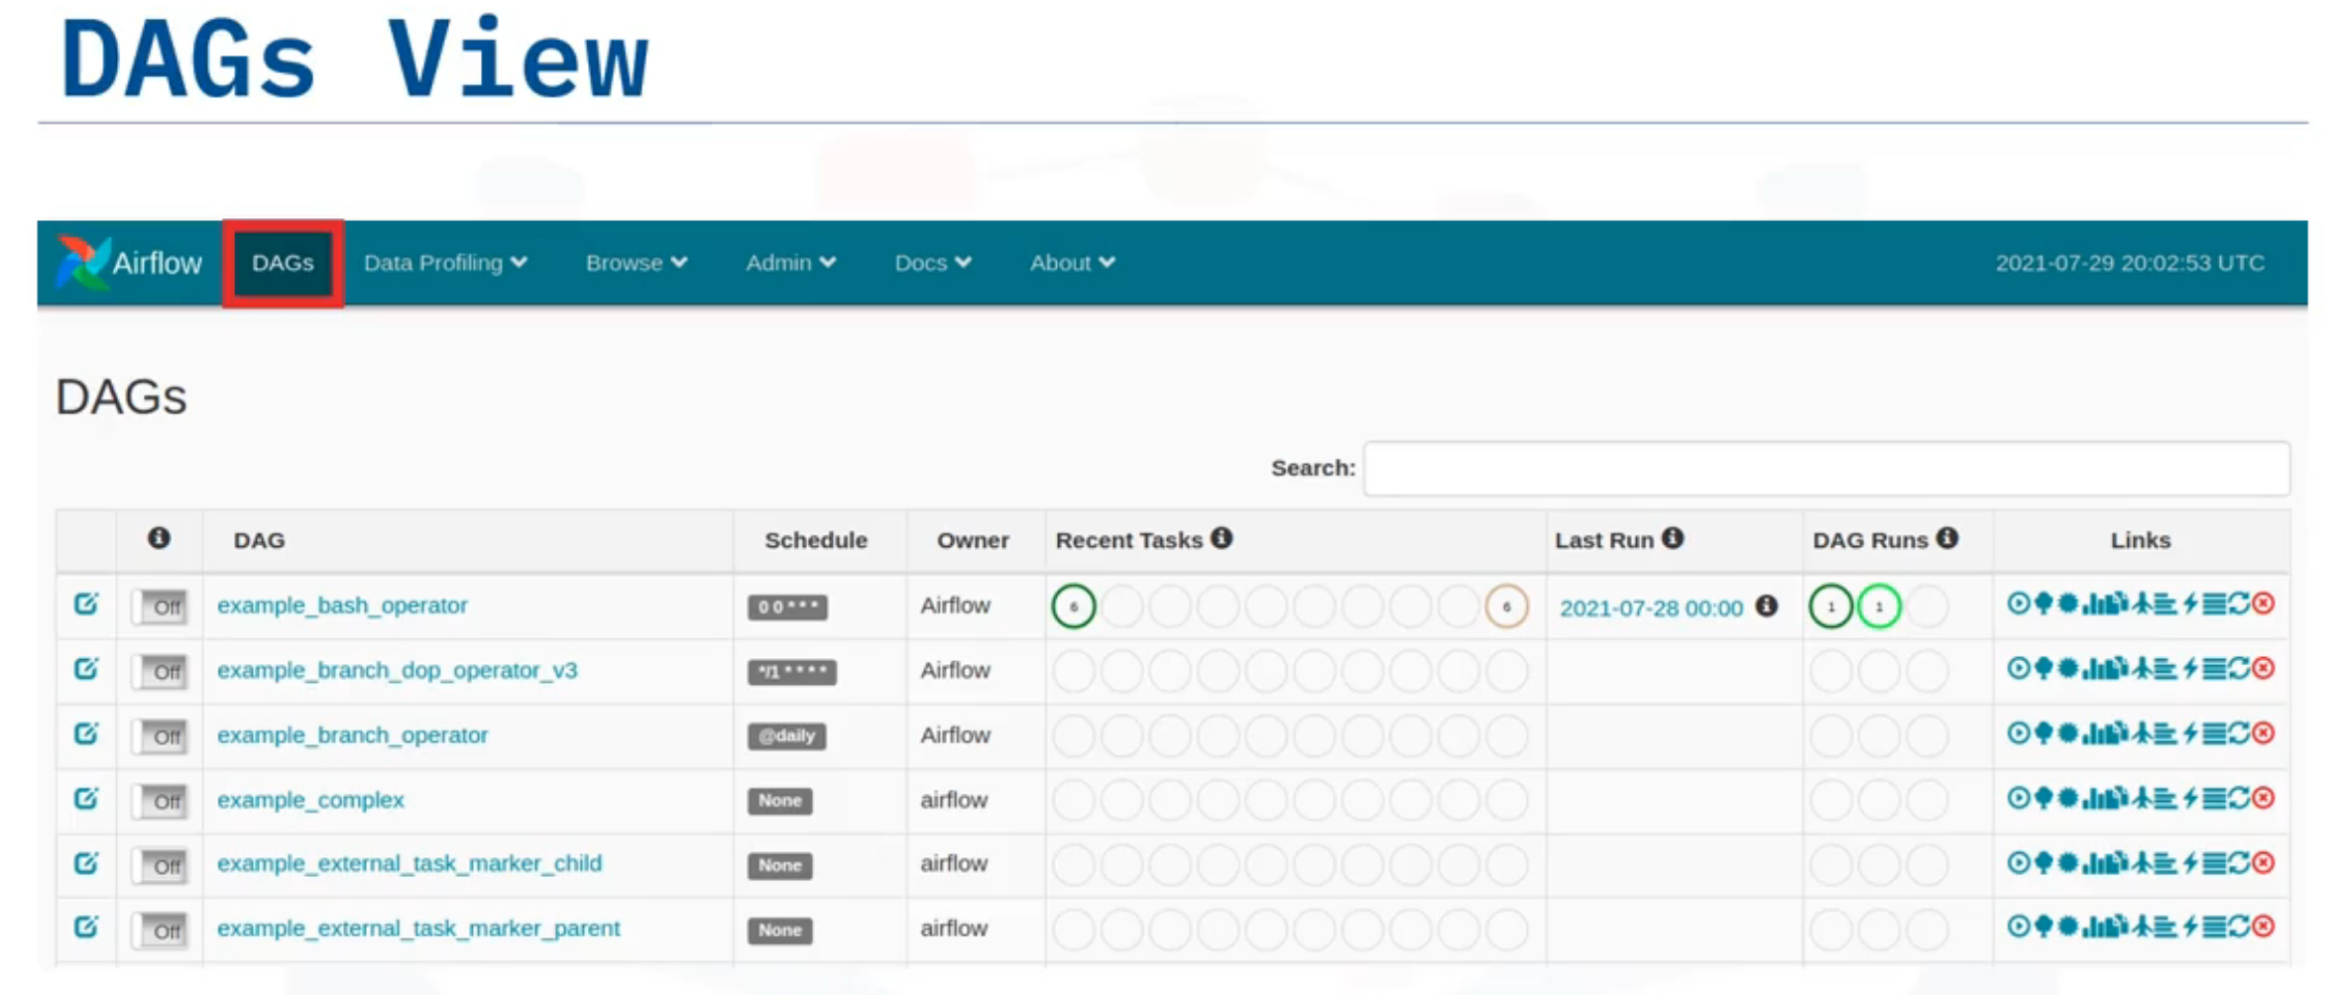

Slide 18
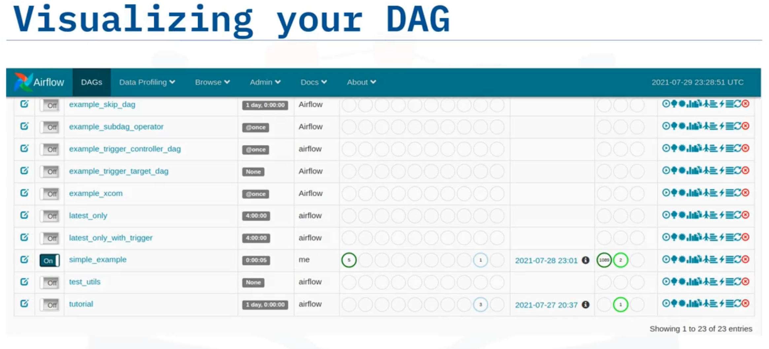

Slide 19
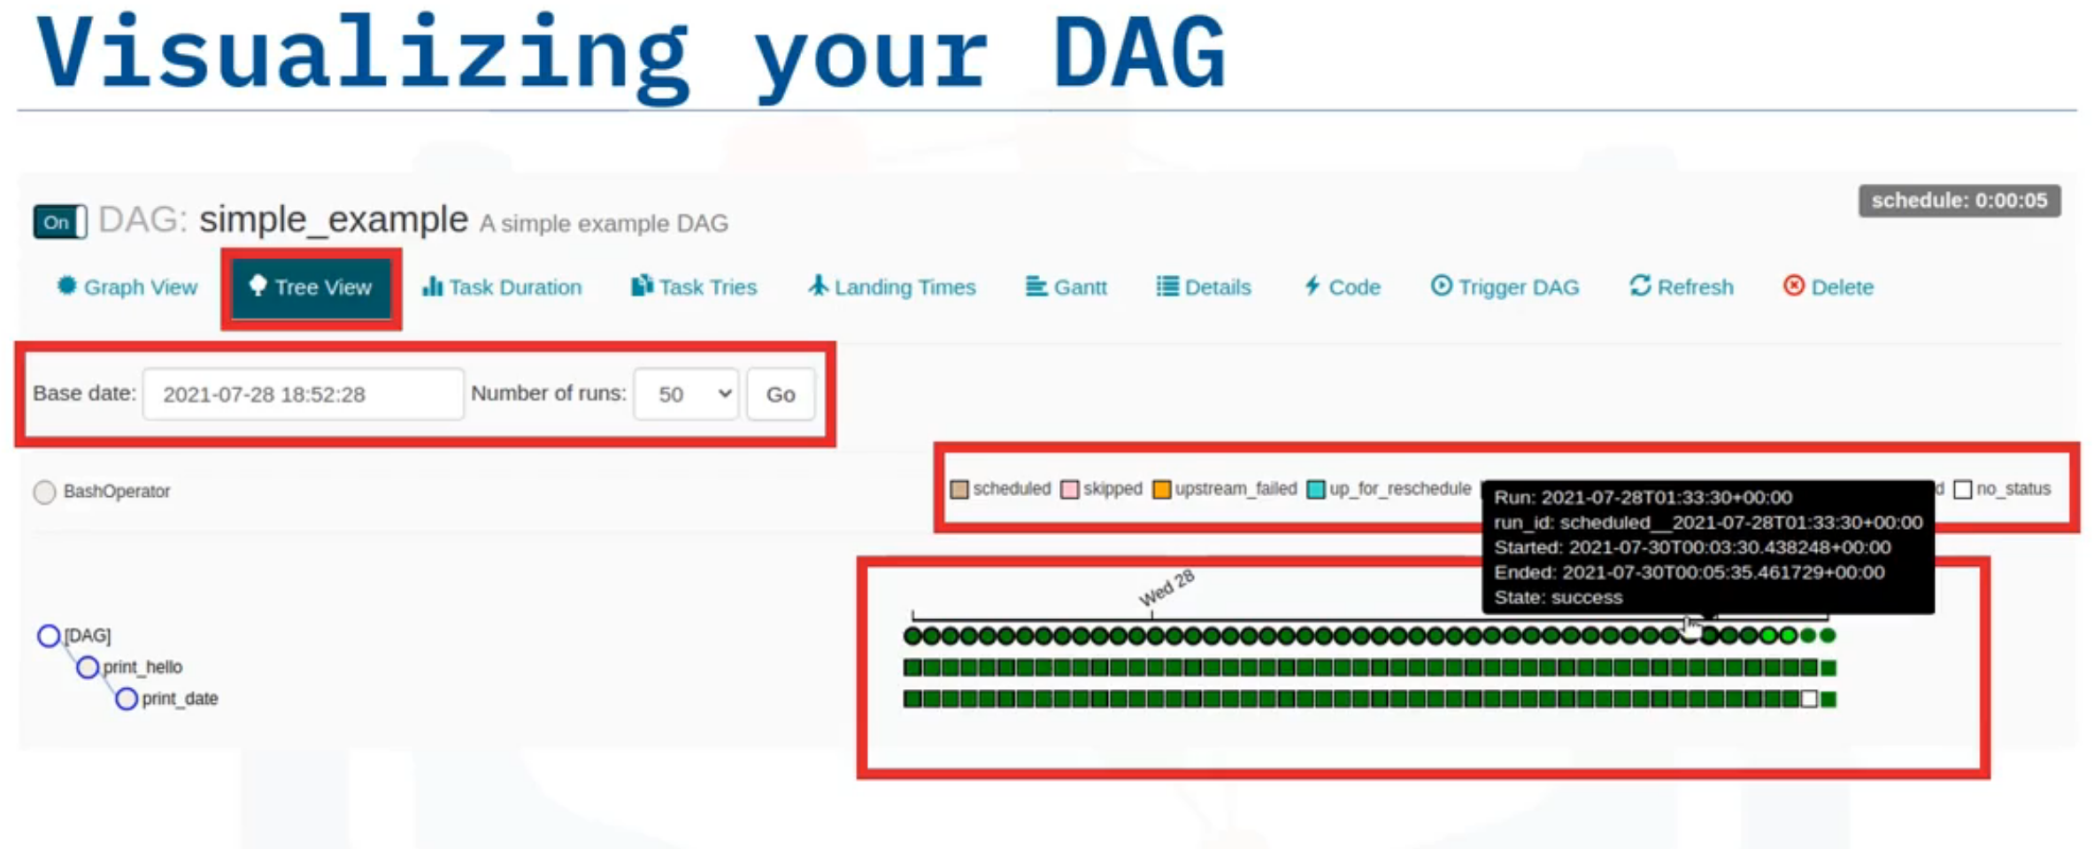

Slide 20
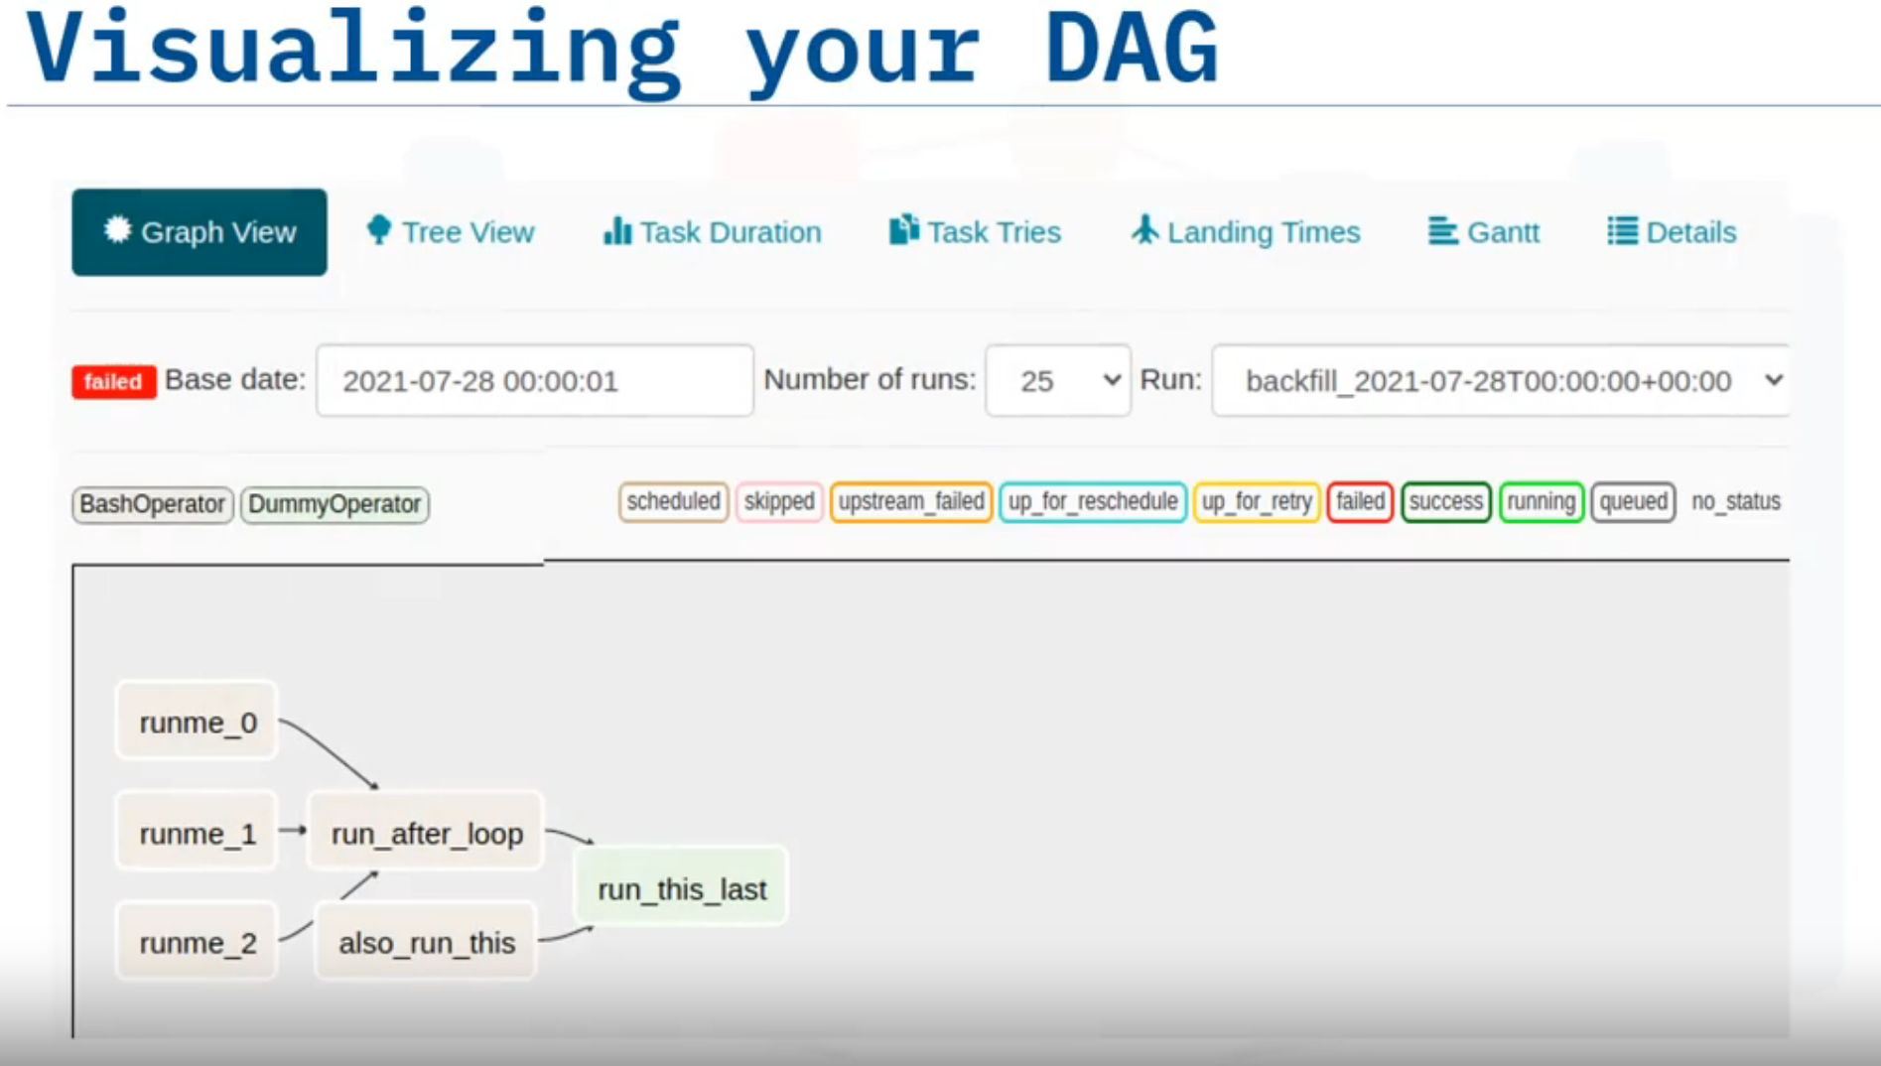

Slide 21
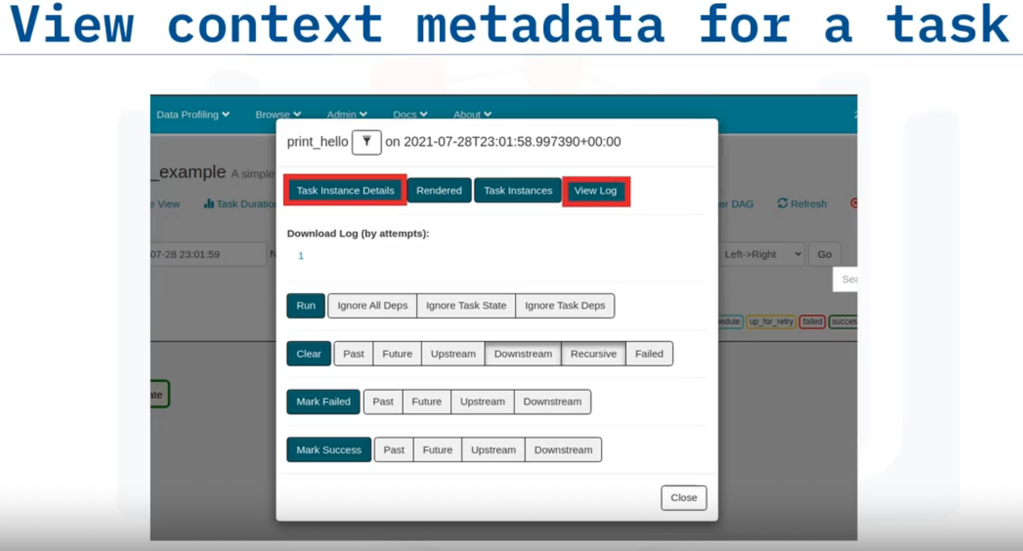

Slide 22
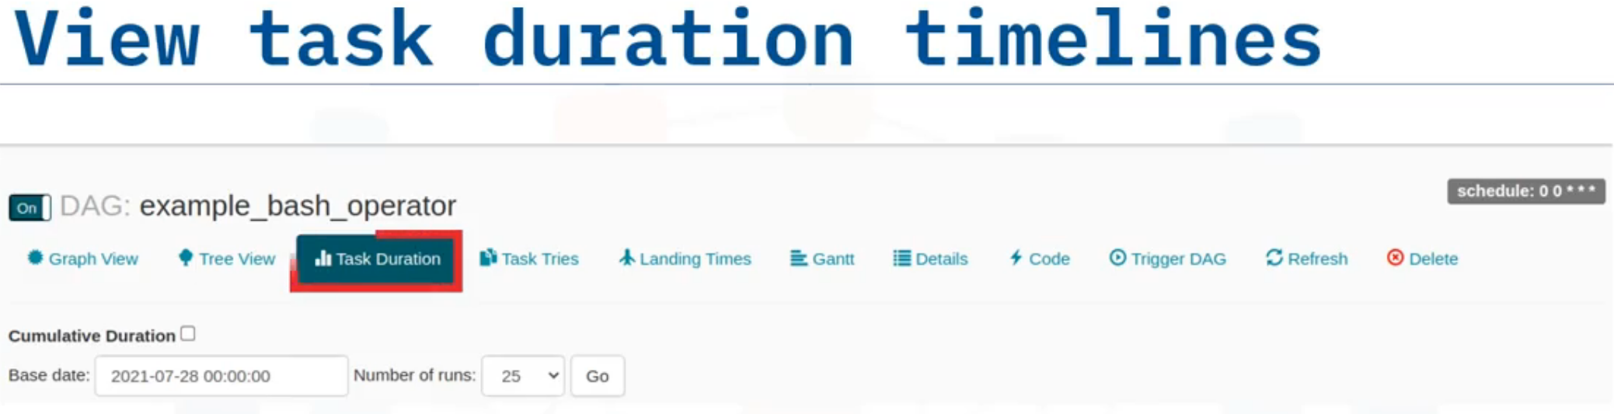
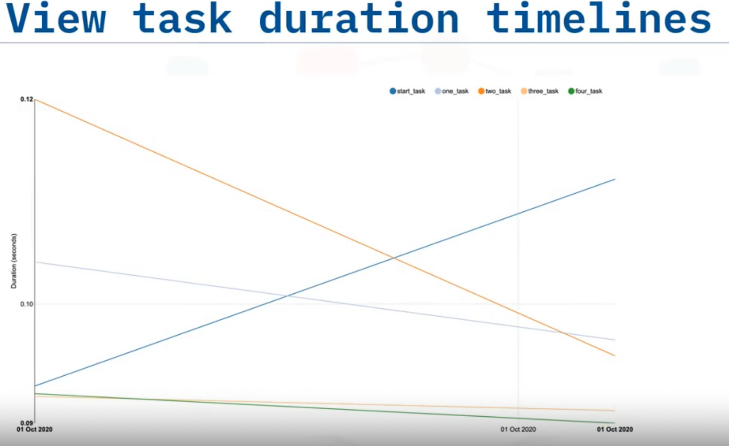

Slide 23
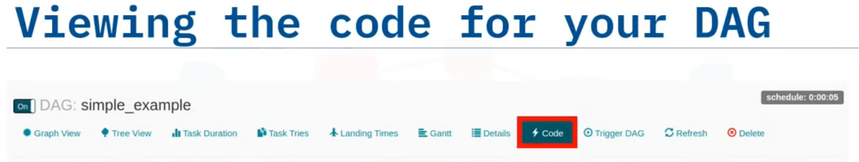
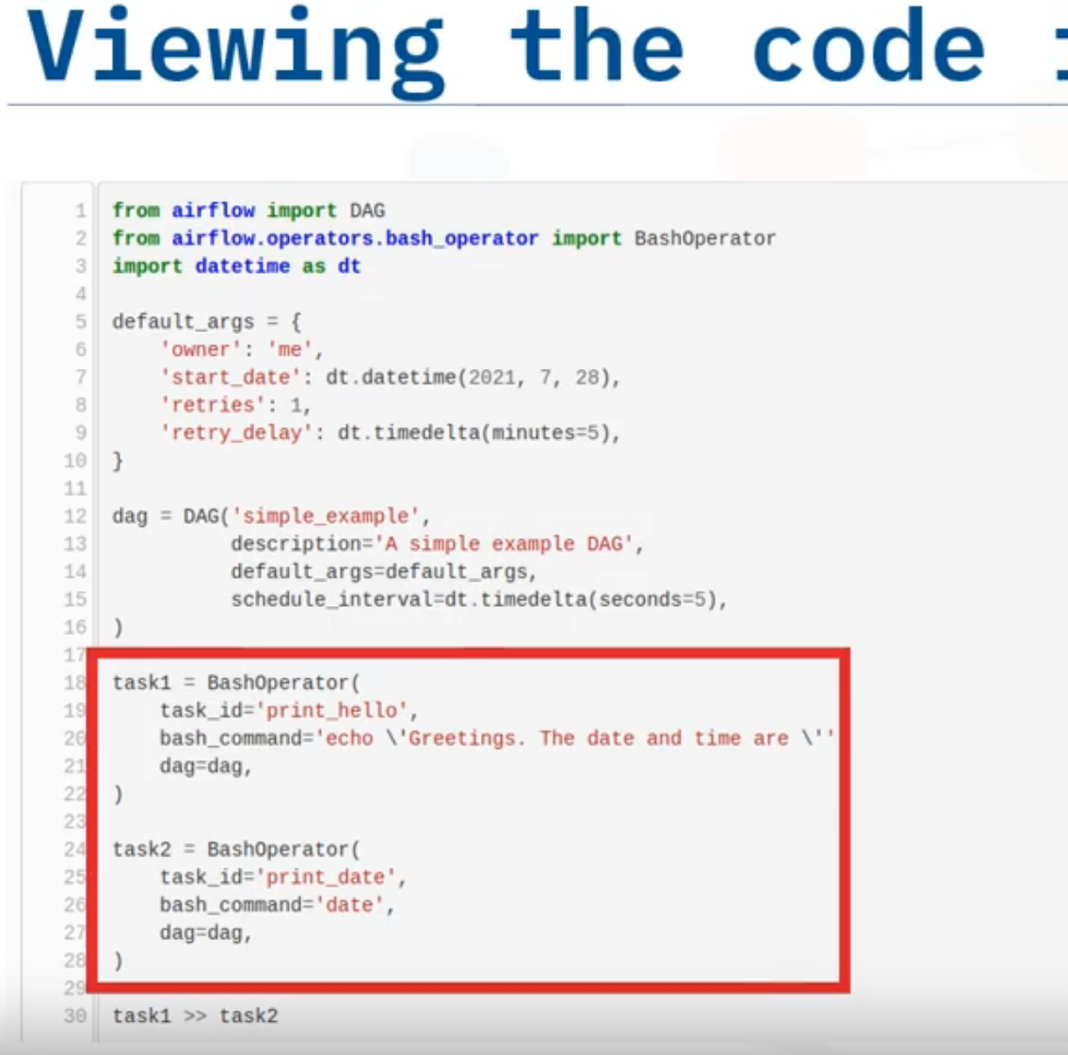

Slide 24
Build DAG using Airflow
Interpret an Airflow pipeline as a Python script that defines an Airflow DAG object.
List the key components of a DAG definition file.
Create tasks by instantiating operators in your DAG definition file.
Set up dependencies amongst tasks

Slide 25
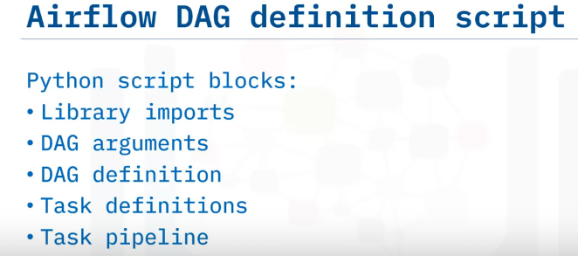
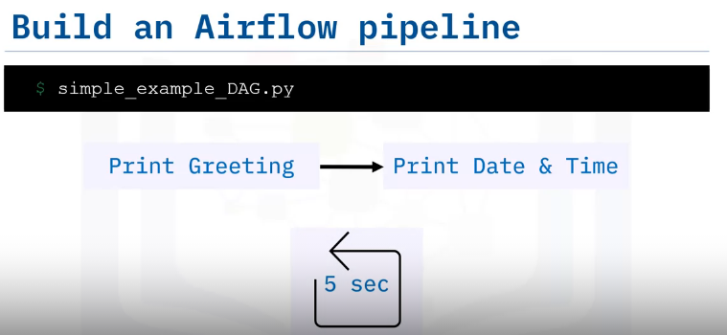
Let's implement a simple Apache Airflow pipeline by writing a DAG definition script.
We will create a very simple pipeline called 'simple example DAG.py', that prints a greeting, and then prints the current date and time.
We will also schedule it to repeat the process every five seconds.

Slide 26
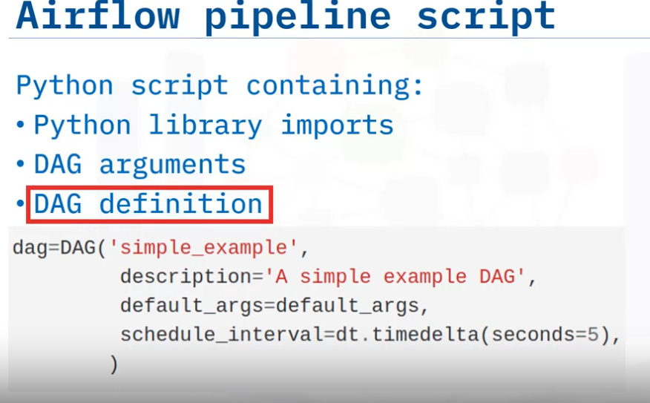
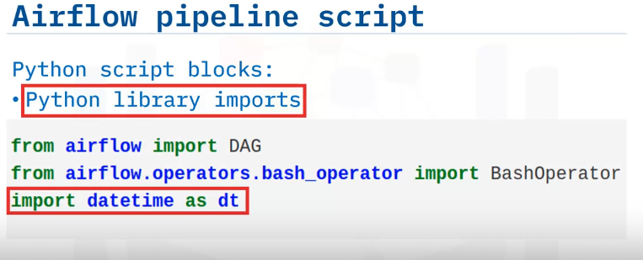
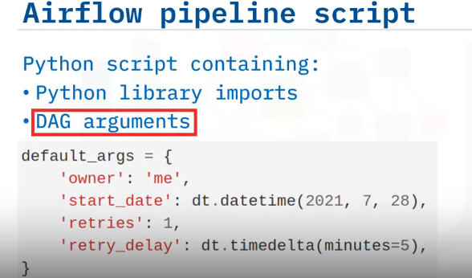
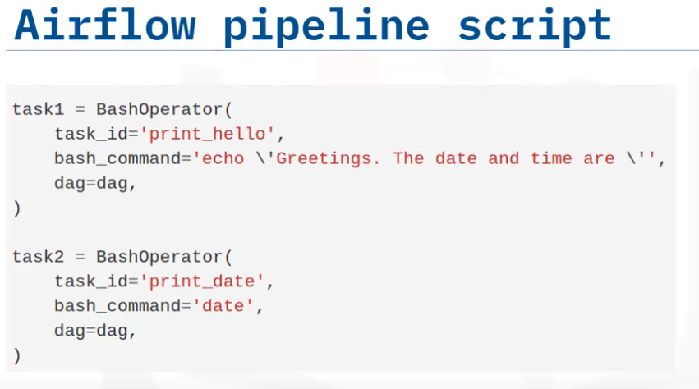
1. Library Import
3.DAG Definition
2. DAG Arguments
4.Task Definition

Slide 27
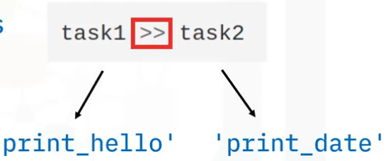
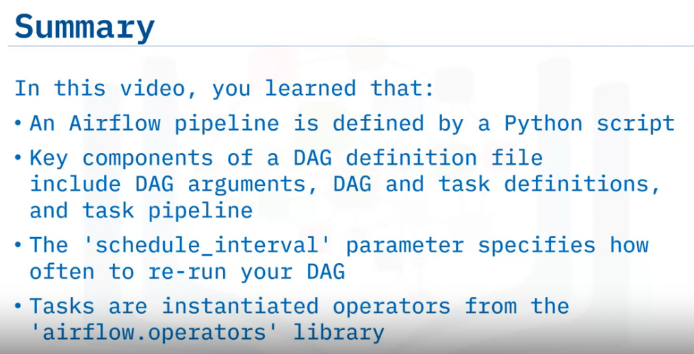
5.Task Pipeline
The final block is where you specify the dependencies for your workflow, like this.
Here, the double 'greater than' notation specifies that task two is downstream from task one.
This means that task one, which we named 'print hello', will run first.
Once 'print hello' runs successfully, task two, or 'print date', will run.

Slide 28
Airflow Monitoring & Logging
Use logging capabilities to monitor the status and diagnose problems with DAG runs.
Explain accessing emitted metrics such as counters, gauges, and timers.

Slide 29
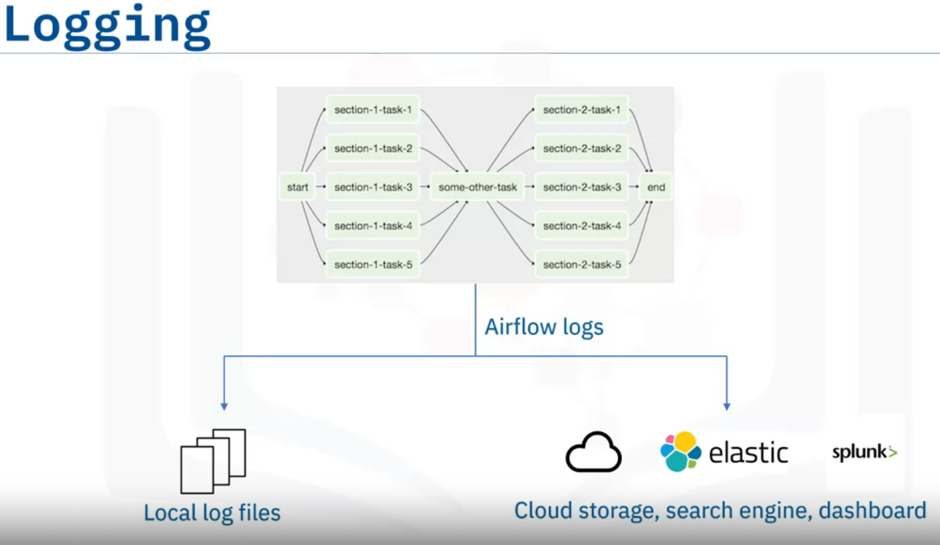
The logging capability is required for developers to monitor the status of tasks in DAG runs, and to diagnose and debug issues.
By default, Airflow logs are saved to local file systems as log files. This makes it convenient for developers to quickly review the log files, especially in a development environment.
For Airflow production deployments, the log files can be sent to cloud storage such as IBM cloud, AWS, or Azure for remote accessing.
The log files can also be sent to search engines and dashboards for further retrieval and analysis. Airflow recommends using Elasticsearch and Splunk, which are two popular document database and search engines, to index, search, and analyze log files.

Slide 30
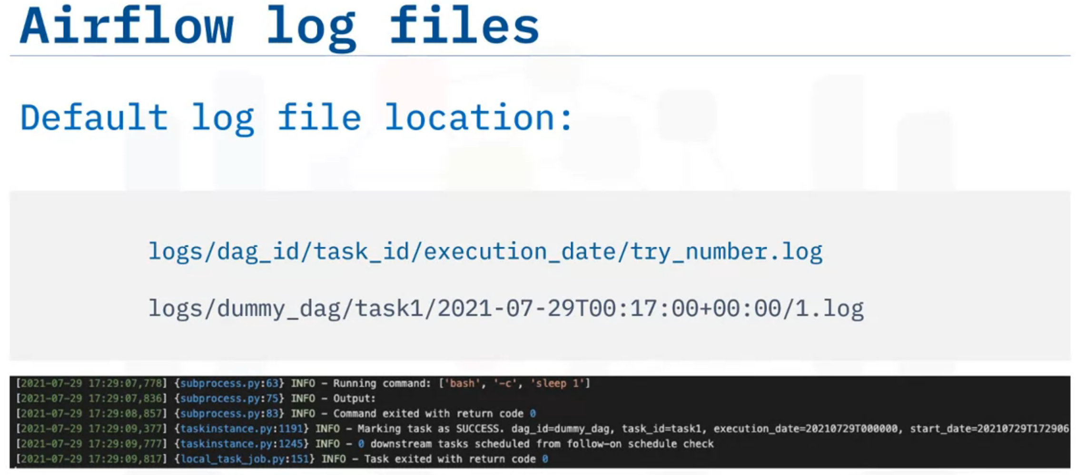
By default, log files are organized by DAG IDs and Task IDs, and you can find a specific log file for a task execution using the following path convention:
logs/dag_id/task_id/execution_date/try_number.log
example, suppose you want to find the log of the first execution try of task 1 in a dummy DAG at a specific time.
You can go to the folder logs/dummy_dag/task1/execution_date/1.log
if you click the first log file, you can check a lot of useful information, such as: the running command, command results, task results, and so on.

Slide 31
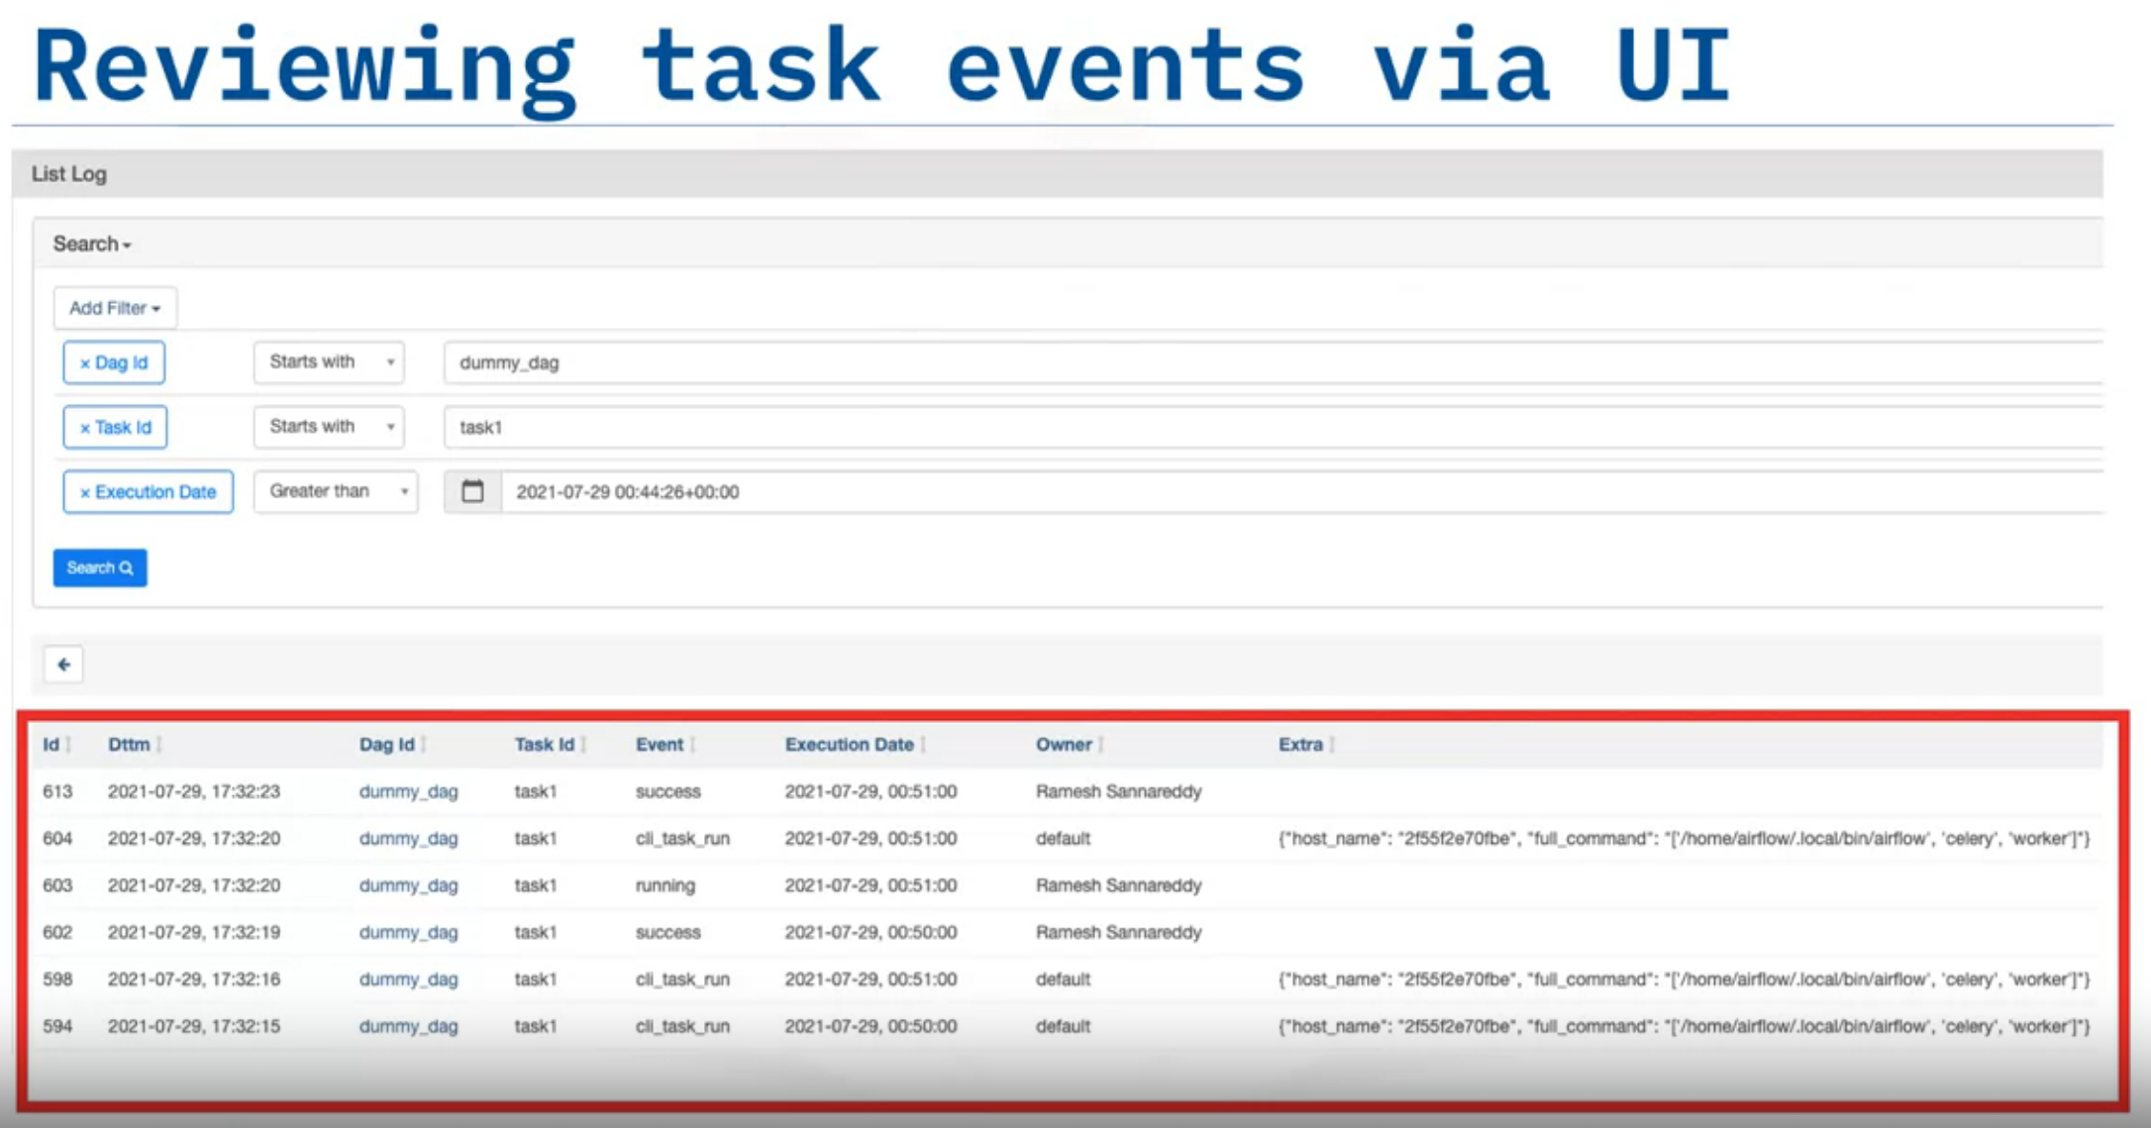
check a lot of useful information, such as: the running command, command results, task results, and so on.
You can also quickly review the task events via UI provided by the Airflow webserver.
You can search events with fields like DAG ID, Task ID, and Execution Date, and quickly get an overview of the specific DAGs and tasks you are looking for.

Slide 32
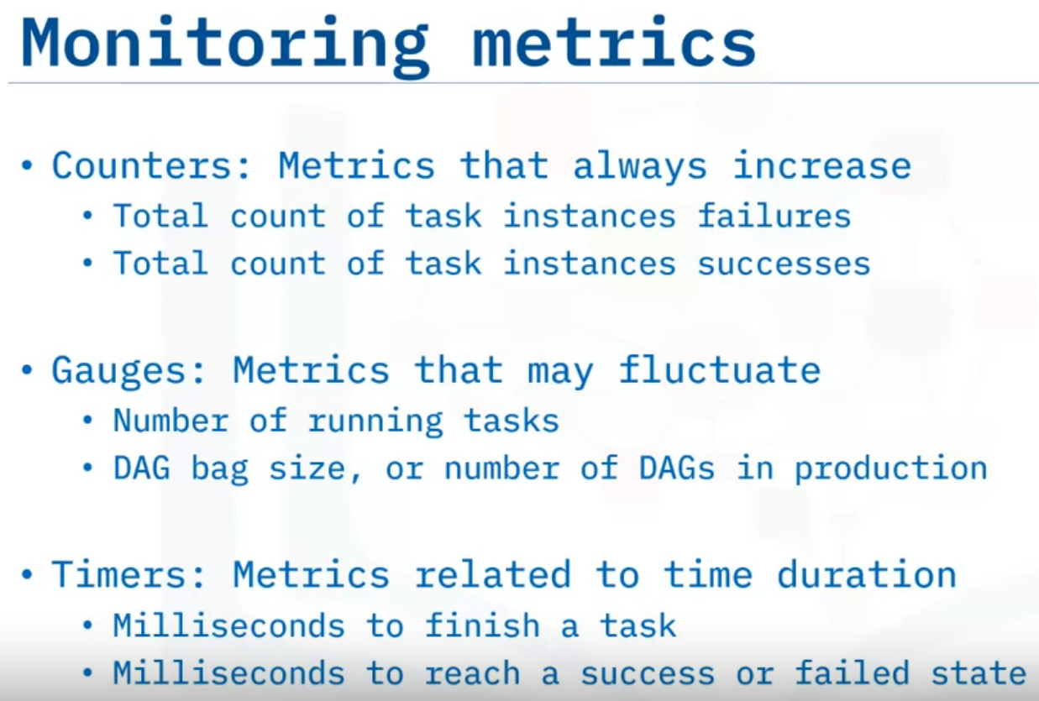
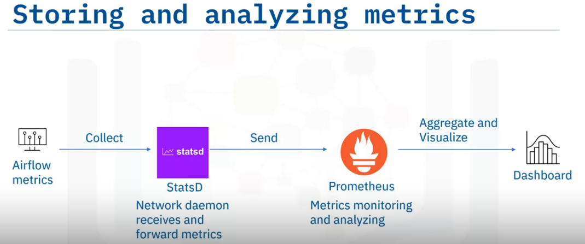
Similar to logs, the metrics produced in Airflow production deployments should be sent and analyzed by dedicated repositories and tools.
Airflow recommends using StatsD, which is a network daemon that can gather metrics from Airflow and send them to a dedicated metrics monitoring system.
For metrics monitoring and analysis, Airflow recommends using Prometheus, which is a popular metrics monitoring and analysis system.
Prometheus can also aggregate and visualize metrics in a dashboard for more interactive visual analytics.

Slide 33
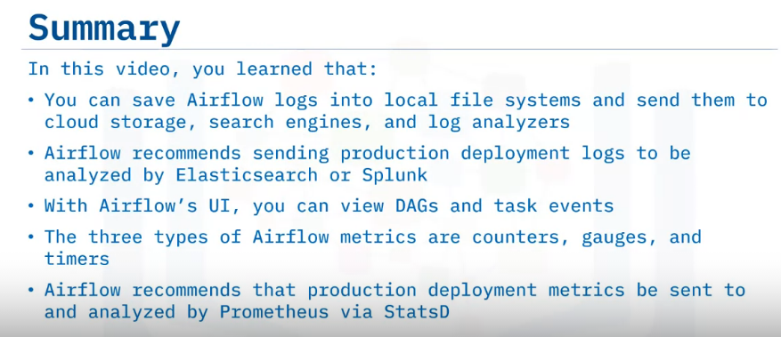

Slide 34
Summary & Highlights
Congratulations! You have completed this module. At this point, you know:
Apache Airflow is scalable, dynamic, extensible, and lean
The five main features of Apache Airflow are pure Python, useful UI, integration, easy to use, and open source
A common use case is that Apache Airflow defines and organizes machine learning pipeline dependencies
Tasks are created with Airflow operators
Pipelines are specified as dependencies between tasks
Pipeline DAGs defined as code are more maintainable, testable, and collaborative
Apache Airflow has a rich UI that simplifies working with data pipelines
You can visualize your DAG in graph or tree mode
Key components of a DAG definition file include DAG arguments, DAG and task definitions, and the task pipeline
The ‘schedule_interval’ parameter specifies how often to re-run your DAG
You can save Airflow logs into local file systems and send them to cloud storage, search engines, and log analyzers
Airflow recommends sending production deployment logs to be analyzed by Elasticsearch or Splunk
With Airflow’s UI, you can view DAGs and task events
The three types of Airflow metrics are counters, gauges, and timers
Airflow recommends that production deployment metrics be sent to and analyzed by Prometheus via StatsD

